Slide 1


DataFlows
Please mute yourself. Thank you!

Slide 2
Learning Objectives
You will learn the following concepts:
What is Data Flow
Data Flows vs Datasets
Creating and Managing Data Flows

Slide 3
Data Flow
What is Data Flow
Dataflow is a fully managed streaming analytics service that minimizes latency, processing time, and cost through autoscaling and batch processing.
In Power BI
A dataflow is a collection of tables that are created and managed in workspaces in the Power BI service.
A table is a set of columns that are used to store data, much like a table within a database
Notes:
Through the past few discussions, you've had the chance to do a myriad of tasks, loading and transforming data from a number of sources, building visuals, creating DAX equations, maybe even publishing a report or two to Power BI Service, but what's next? The next step on our data analysis journey is to share these reports with our wider audiences and organizations. We can do this in a workspace, a feature of Power BI Service. A workspace is a centralized repository in which you can collaborate with colleagues and teams to create collections of reports and dashboards.
Workspaces offer the following benefits:
Allow you to share and present reports and dashboards in a single environment.
Ensure that the highest level of security is maintained by controlling who can access datasets, reports, and dashboards.
Focus collaboration efforts as workspaces can be used to house reports and dashboards for use by multiple teams.

Slide 4
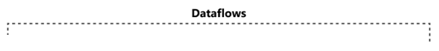
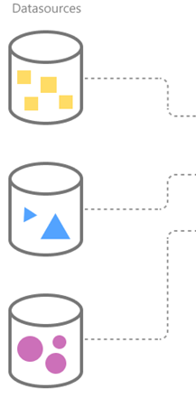
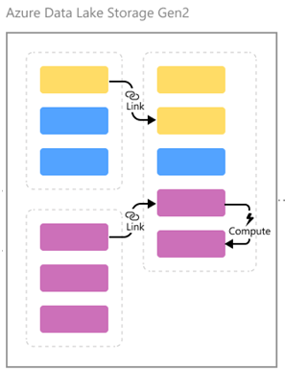
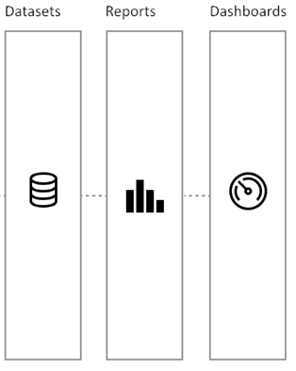

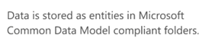
Data Flow Architecture
So datasets instead of getting data from on-premise or live data sources, datasets are getting data from Azure Data Lake using data flows.

Slide 5
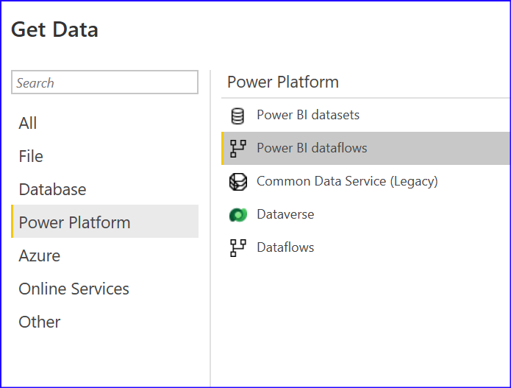
Power BI Desktop and Data Flow
Power BI has a Get data option from Dataflow.
You can simply Get Data from a Dataflow in Power BI, and choose the table that you want.

Slide 6
Why Data Flows?
With Power BI, we connect with different data sources, and tables are generated for each report.
If you want to use the same table in another file /report, with a combination of some other tables which is not in the first file, then you would need to create connection to source, select tables in the new *.pbix file.
To reduce the duplication, we can create a Data Flow, which pulls data from various sources, applies transformations( if needed), and same can be referenced by both datasets /reports

Slide 7
Data Flow Architecture
Dataset 1
Dataset 2

Slide 8
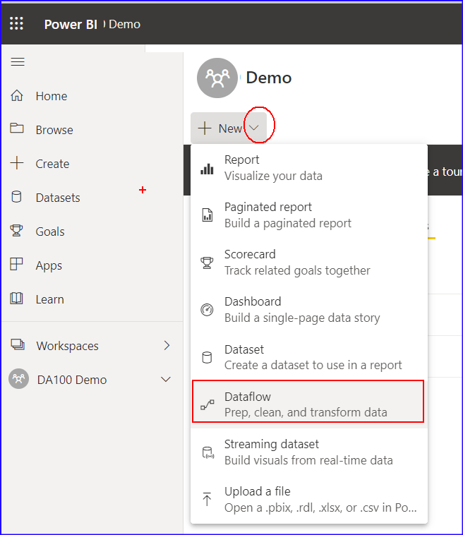
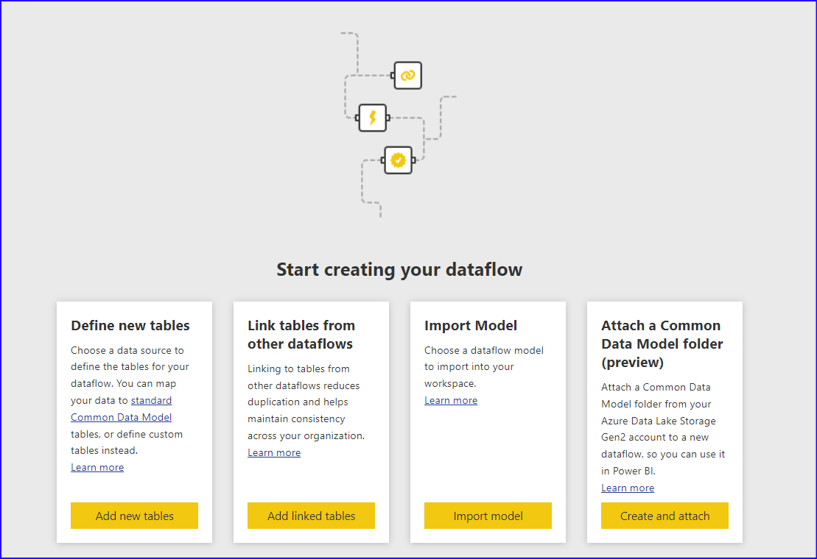
Creating Data Flow
To create a new Data Flow,
Click on dropdown next to New button in Power BI Service and
Select Data Flow
And it will show the screen as follows

Slide 9
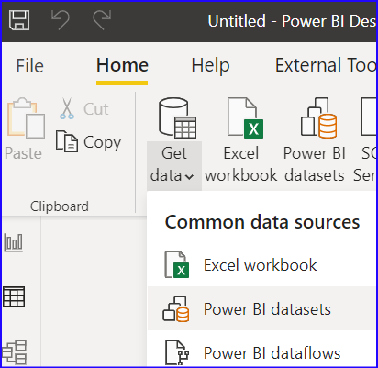
Using Data Flow
We can reference the existing dataflow
In Power BI Desktop, select Get Data | Power BI dataflow and existing data flows will be shown.
Thereafter report can be created.

Slide 10
Lab: Create DataFlow

Slide 11
Module Overview
We covered the following concepts:
What is Data Flow
Data Flows vs Datasets
Creating and Managing Data Flows
Notes:
In this module we discussed:
How to create, manage and secure workspace in Power BI.
How to share and manage Power BI assets.

